Slide 1
Winter Winning Camp
DATABASE MANAGEMENT SYSTEM
Department Of Career Planning & Development

Slide 2
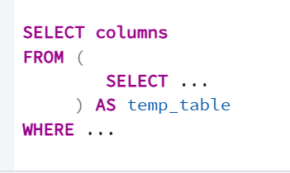
Subqueries:
A subquery is a query inside another SQL query.
It runs first and gives output to the outer query.
Types of Subquery:
(i) Inline subquery : An inline subquery is a SELECT query written inside another SELECT query (usually inside the FROM clause).
It works like a temporary table inside the main query.
Syntax:

Slide 3
(ii) Nested Subquery:
Subquery inside Subquery is a nested Subquery
(iii) Multi-Row Subquery :
A multi-row subquery returns multiple rows, and you must use operators like:
IN
ANY
ALL
EXISTS

Slide 4
(iv) Correlated subquery : A correlated subquery is a subquery that depends on a value from the outer query.
The subquery runs again and again for each row of the outer query.
It uses a column from the outer query inside the inner query.
It is slower than non-correlated subqueries
(v) Scaler Subquery: A scalar subquery is a subquery that returns exactly one value (one row & one column).

Slide 5
(vi) SELF-CONTAINED SUBQUERY (NON-CORRELATED SUBQUERY) :
A self-contained subquery is a subquery that does NOT depend on the outer query.
It can run independently
=>It returns a value used by the outer query
=>Outer query does NOT supply data to the inner query
=> Also called non-correlated subquery
Example: With in ,all ,any, find second highest salary

Slide 6
Table of Self-Contained Subquery
Type | Example | Dependent on Outer Query? | Self-Contained?
Subquery in WHERE | salary > (SELECT AVG) | No | Yes
Subquery in SELECT | Select name,(Select COUNT(*) from Employees) | No | Yes
Subquery in FROM | Temp table | No | Yes
IN / ANY / ALL | dept_id IN (SELECT) | No | Yes
EXISTS (if no outer reference) | EXISTS(SELECT 1) | No | Yes

Slide 7
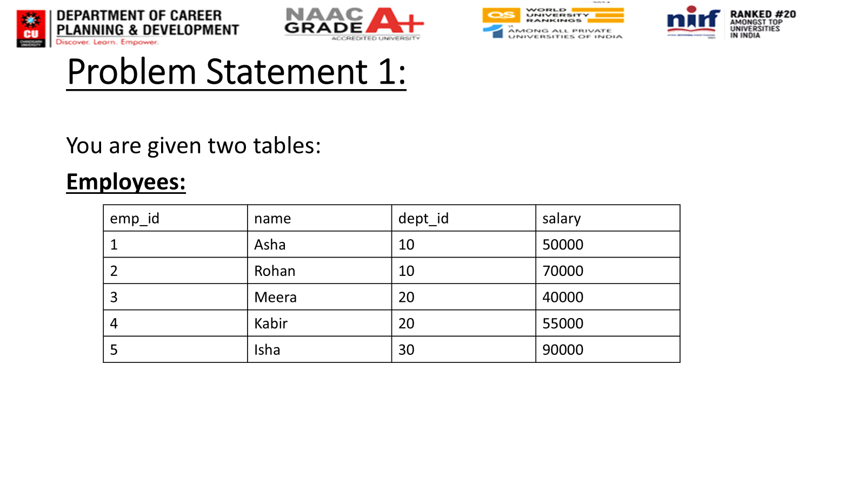

Slide 8
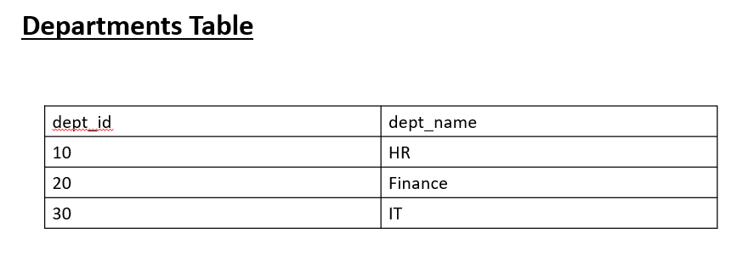
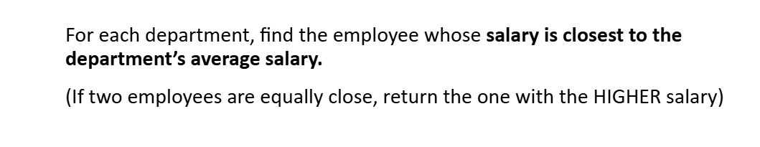

Slide 9
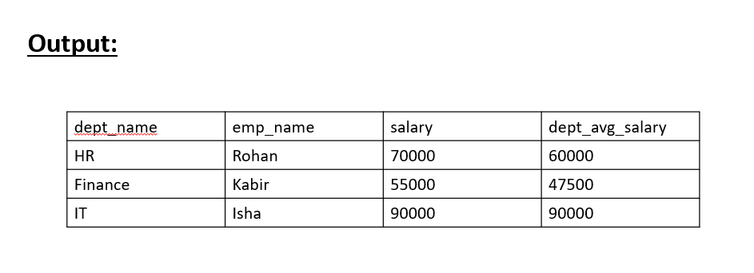

Slide 10
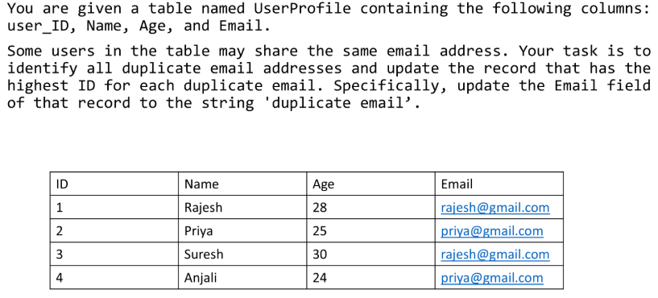
Ques 2:

Slide 11
